Slide 1
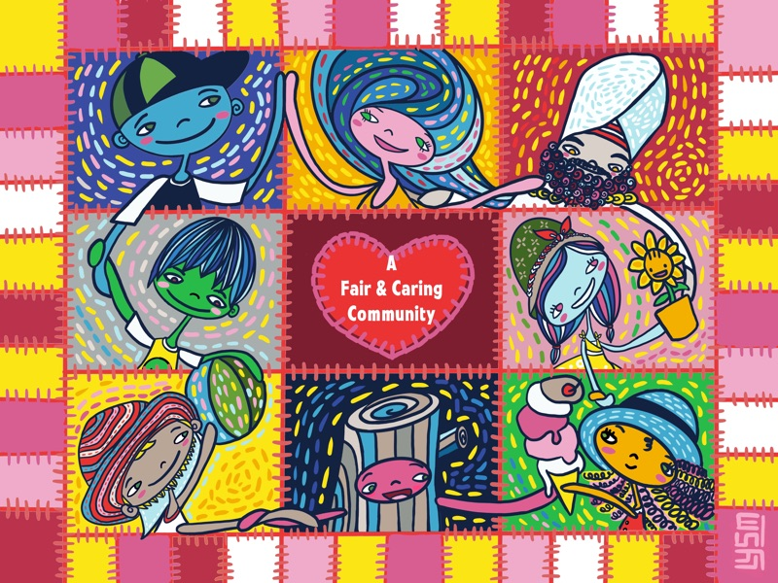
Curtains Up! A whole-class activity of Stories of Casual Racism

Slide 2
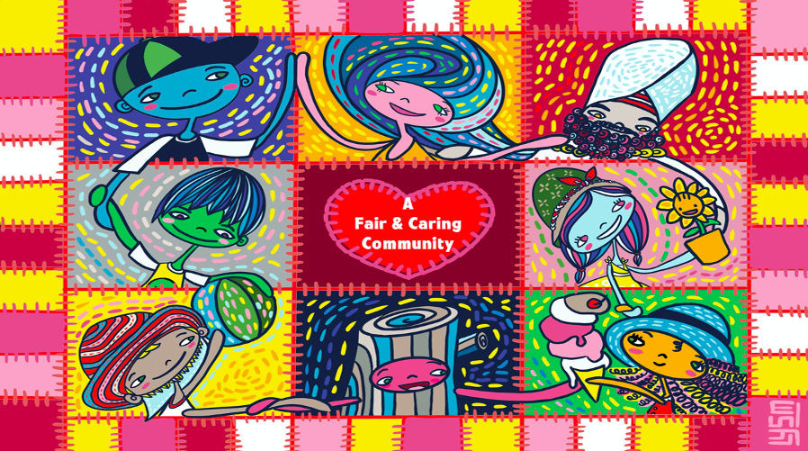
Introduction
“Curtains Up!” is a drama project that your whole class can take part in.
The project is about “everyday racism”. First, read about casual racism. You will find nine very interesting articles at http://about.whatsup.sg/.
Racism means to treat some people worse than others, just because they are of a different race or skin colour, come from a different place, or have a different culture.
Everyday racism is a form of racism where people say or do hurtful things without intending to be unkind. It happens all around us but many people do not even recognise it.
Everyday racism is also called “casual racism”, although there is nothing casual about it for the person at the receiving end.

Slide 3
Behind the Scenes - your heart & your head
“Stories of Casual Racism” has many anecdotes – real-life stories – about everyday racism.
Several adults shared their experiences with the writer, Shan, because they wanted you to learn about this type of racism. Knowing what it is and being able to spot it is your “head knowledge”. Head knowledge is important.
We must also have “heart knowledge” which relies on our feelings. Only then can we have empathy for others when we imagine how they feel.
“Curtains Up!” uses drama to get both your head and your heart to work together so that you have a strong, healthy understanding of casual racism.
Taking part will help you to think of ways to make your classroom community more caring and fairer towards all children and adults.
If you have been hurt by racism in your own life,
please know that you do not have to share your experiences for this activity.

Slide 4
Set the Stage
Divide your class into seven groups: Groups 1 to 7.
Collect a handout, “Group Instructions”, from your teacher. Each group gets a different handout. Read your group’s handout. It tells you what to do.
You are ready to work on your one-act play!
When you work in your groups to prepare your one-act plays,
be sensitive to one another. Respect every student.
Your journey to becoming a kinder, more caring human being
STARTS RIGHT NOW.

Slide 5
Prepare Your Play
Read and follow your Group Instructions.
Agree on a role for every member of your group.
Discuss and create a one-act play about casual racism. Your performance should be within 10 minutes. In your play, tell a story of how all the characters have gained from the experience.
Rehearse your play.
Does your group’s article make you very uncomfortable?
Is the group not a good fit for you?
Talk to your teacher about it.
You may be able to swap places with a student in another group.

Slide 6
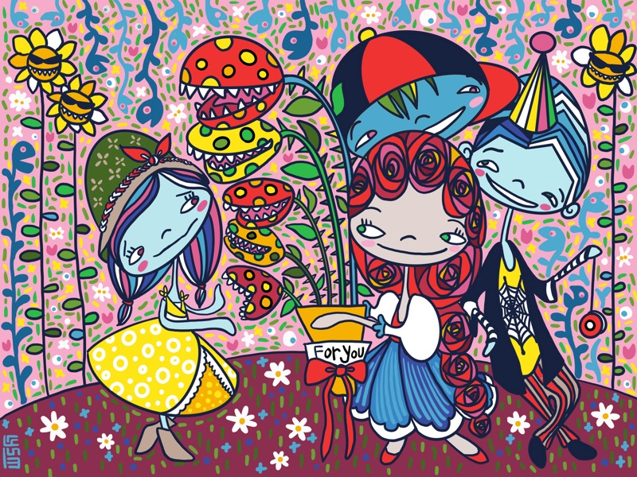
Group 1 - Was that a compliment or an insult?
Group Instructions
Character Roles
Read & Discuss
Read the article “Was that a compliment or an insult?”.
Discuss and come up with a 10-minute one-act play based on any part of the article or the illustration.
Define the Characters
Who are the characters? What will each of their personalities be like?
How will they look and behave?
Develop your play
Where and when does your story take place?
What are the compliments that hurt?
What do the Victims say that is both empowered and kind?
In what ways do the Friends help in this situation?
When the Offenders realise their casual racism, what do they say or do?
How does the story end happily for everyone?
What do you want your audience to learn or take home from your play?
Set the stage
What are some simple props you can use to help you tell your story?
Victims 1 & 2
You are a character who receives the compliment(s) that hurt. You respond to the casual racism in a healthy way. This makes you a hero as a survivor.
Offenders 1 & 2
You are a character who unintentionally gives the compliment(s) that hurt. You make the situation right after realising this.
Friends 1 & 2
You are a character who notices the casual racism, and makes the offenders realise the hurt they caused. Your advice can help develop understanding and empathy.
Please note: Groups that have fewer than six members need to ensure that there is at least 1 Victim, 1 Offender and 1 Friend in your story.
Reminder: Your play should end with all characters wanting to help reduce casual racism. This means, every character gains from the experience.

Slide 7
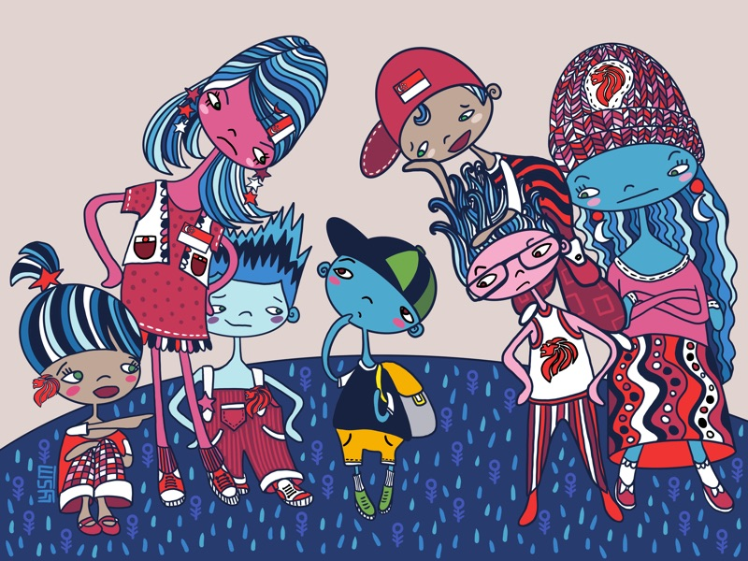
Group 2 – “You don’t look Singaporean.”
Group Instructions
Character Roles
Read & Discuss
Read the article, “You don’t look Singaporean”.
Discuss and come up with a 10-minute one-act play based on any part of the article or the illustration.
Define the Characters
Who are the characters?
What will each of their personalities be like?
How will they look and behave?
Develop your play
Where and when does your story take place?
What made the Victims feel less local because of the way they looked?
What do the Victims say that is both empowered and kind?
In what ways do the Friends help in this situation?
When the Offenders realise their casual racism, what do they say or do?
How does the story end happily for everyone?
What do you want your audience to learn or take home from your skit?
Set the stage
What are some simple props you can use to help you tell your story?
Victims 1 & 2
You are a character who is made to feel less local because of the way you look. You respond to the casual racism in a healthy way. This makes you a hero as a survivor.
Offenders 1 & 2
You are a character who makes the Victim(s) feel less local because of the way he/she looks. You become more inclusive after realising the hurt caused to the Victim(s).
Friends 1 & 2
You are a character who notices the casual racism, and helps the other characters look beyond judgements and stereotypes. Your advice can help the characters be more inclusive.
Note: Groups that have fewer than six members need to ensure that there is at least 1 Victim, 1 Offender and 1 Friend in your skit.
Reminder: Your play should end with all characters wanting to help reduce casual racism. This means, every character gains from the experience.

Slide 8
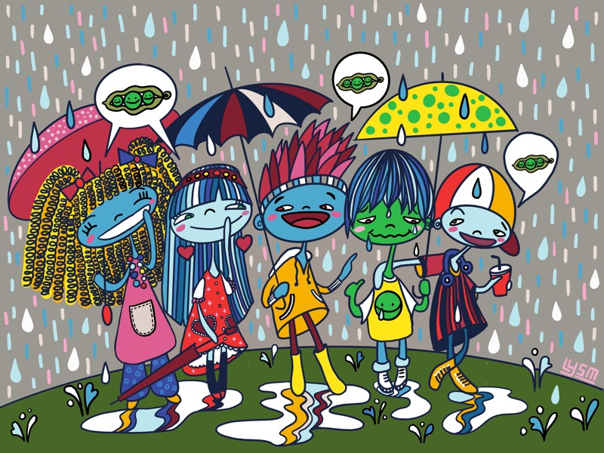
Group 3 - Racial jokes: “But they’re cool with it!”
Group Instructions
Character Roles
Read & Discuss
Read the article “Racial jokes: ‘But they’re cool with it!’”.
Discuss and come up with a 10-minute one-act play based on any part of the article or the illustration.
Define the Characters
Who are the characters?
What will each of their personalities be like?
How will they look and behave?
Develop your play
Where and when does your story take place?
How were the Victims made to feel bad because of insensitive jokes?
What do the Victims say that is both empowered and kind?
In what ways do the Friends help in this situation?
When the Offenders realise their casual racism, what do they say or do?
How does the story end happily for everyone?
What do you want your audience to learn or take home from your skit?
Set the stage
What are some simple props you can use to help you tell your story?
Victims 1 & 2
You are a character who is made to feel bad because of insensitive jokes. You respond to the casual racism in a healthy way. This makes you a hero as a survivor.
Offenders 1 & 2
You are a character who makes the Victim feel bad with your insensitive joke. You make the situation right after realising the hurt the insensitive jokes have caused.
Friends 1 & 2
You are a character who notices the casual racism, and makes the offenders realise their mistakes and the hurt they cause. Your advice can help the characters be more understanding and kind.
Note: Groups that have fewer than six members need to ensure that there is at least 1 Victim, 1 Offender and 1 Friend in your skit.
Reminder: Your play should end with all characters wanting to help reduce casual racism. This means, every character gains from the experience.

Slide 9
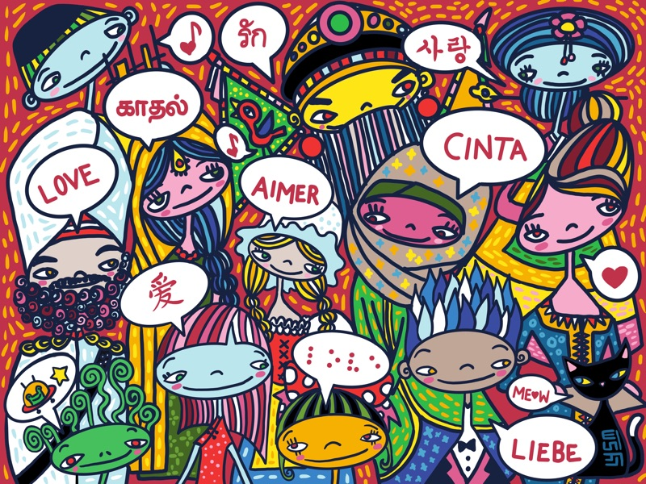
Group 4 – Language can be a weapon
Group Instructions
Character Roles
Read & Discuss
Read the story “Language can be a weapon”.
Discuss and come up with a 10-minute one-act play based on any part of the article or the illustration.
Define the Characters
Who are the characters?
What will each of their personalities be like?
How will they look and behave?
Develop your play
Where and when does your story take place?
How was language used as a weapon to hurt the Victims?
What do the Victims say that is both empowered and kind?
In what ways do the Friends help in this situation?
When the Offenders realise their casual racism, what do they say or do?
How does the story end happily for everyone?
What do you want your audience to learn or take home from your skit?
Set the stage
What are some simple props you can use to help you tell your story?
Victims 1 & 2
You are a character who feels hurt by the language used. You respond to the casual racism in a healthy way. This makes you a hero as a survivor.
Offenders 1 & 2
You are a character who hurts the Victim by using language as a weapon. You make the situation right after realising the hurt caused to the Victim(s).
Friends 1 & 2
You are a character who notices the casual racism, and makes the other characters realise how to be more inclusive with the choice of language used. Your advice can help encourage understanding.
Note: Groups that have fewer than six members need to ensure that there is at least 1 Victim, 1 Offender and 1 Friend in your skit.
Reminder: Your play should end with all characters wanting to help reduce casual racism. This means, every character gains from the experience.

Slide 10
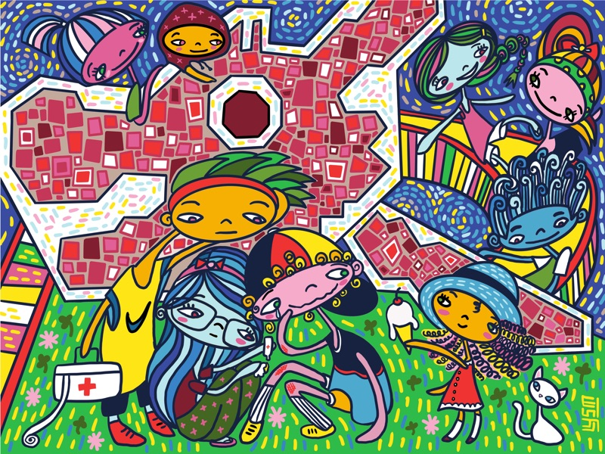
Group 5 - What it means to be friends
Group Instructions
Character Roles
Read & Discuss
Read the article “What it means to be friends”.
Discuss and come up with a 10-minute one-act play based on any part of the article or the illustration.
Define the Characters
Who are the characters?
What will each of their personalities be like?
How will they look and behave?
Develop your play
Where and when does your story take place?
How were the Victims hurt by unkind friends?
What do the Victims say that is both empowered and kind?
In what ways do the Friends help in this situation?
When the Offenders realise their casual racism, what do they say or do?
How does the story end happily for everyone?
What do you want your audience to learn or take home from your skit?
Set the stage
What are some simple props you can use to help you tell your story?
Victims 1 & 2
You are a character who is hurt by unkind friends. You respond to the casual racism in a healthy way. This makes you a hero as a survivor.
Offenders 1 & 2
You are a character who hurts the Victim(s) by being an unkind friend. You try to be a better friend after realising the hurt caused to the Victim(s).
Friends 1 & 2
You are a character who notices the casual racism, and encourages the Offender(s) to become better friends. Your advice can help the characters rethink their intentions and encourage sincerity in friendships.
Note: Groups that have fewer than six members need to ensure that there is at least 1 Victim, 1 Offender and 1 Friend in the skit.
Reminder: Your play should end with all characters wanting to help reduce casual racism. This means, every character gains from the experience.

Slide 11
Group 6 - What’s in a name?
Group Instructions
Character Roles
Read & Discuss
Read the article “What’s in a name?”.
Discuss and come up with a 10-minute one-act play based on any part of the article or the illustration.
Define the Characters
Who are the characters? When deciding on the names, do not use your classmate’s or teacher’s names.
What will each of their personalities be like?
How will they look and behave?
Develop your play
Where and when does your story take place?
How were the Victims’ names not respected?
What do the Victims say that is both empowered and kind?
In what ways do the Friends help in this situation?
When the Offenders realise their casual racism, what do they say or do?
How does the story end happily for everyone?
What do you want your audience to learn or take home from your story?
Set the stage
What are some simple props you can use to help you tell your story?
Victims 1 & 2
You are a character whose name is not respected. You respond to the casual racism in a healthy way. This makes you a hero as a survivor.
Offenders 1 & 2
You are a character who hurts the Victim by laughing at or belittling his/her name. You make the situation right after realising the hurt caused to the Victim(s).
Friends 1 & 2
You are a character who notices the casual racism, and helps the Offender(s) realise their mistake. Your advice can help the need to respect names, culture and identity.
Note: Groups that have fewer than six members need to ensure that there is at least 1 Victim, 1 Offender and 1 Friend in your skit.
Reminder: Your play should end with all characters wanting to help reduce casual racism. This means, every character gains from the experience.

Slide 12
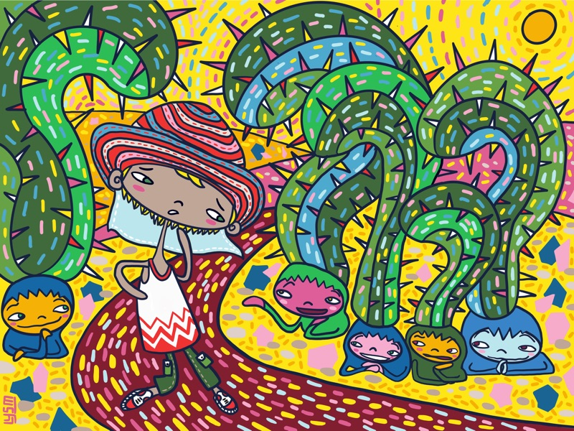
Group 7 - Ouch! What a thoughtless question
Group Instructions
Character Roles
Read & Discuss
Read the article “Ouch! What a thoughtless question”.
Discuss and come up with a 10-minute one-act play based on any part of the article or the illustration.
Define the Characters
Who are the characters?
What will each of their personalities be like?
How will they look and behave?
Develop your play
Where and when does your story take place?
How are insensitive questions directed at the Victims?
What do the Victims say that is both empowered and kind?
In what ways do the Friends help in this situation?
When the Offenders realise their casual racism, what do they say or do?
How does the story end happily for everyone?
What do you want your audience to learn or take home from your skit?
Set the stage
What are some simple props you can use to help you tell your story?
Victims 1 & 2
You are a character who is the target of insensitive questions. You respond to the casual racism in a healthy way. This makes you a hero as a survivor.
Offenders 1 & 2
You are a character who hurts the Victim by asking insensitive questions. You become more considerate after realising the mistake.
Friends 1 & 2
You are a character who notices the casual racism, and makes the Offender(s) reflect on their intentions of their questions. Your advice can encourage the characters be more respectful.
Note: Groups that have fewer than six members need to ensure that there is at least 1 Victim, 1 Offender and 1 Friend in your skit.
Reminder: Your play should end with all characters wanting to help reduce casual racism. This means, every character gains from the experience.

Slide 13
Present Your Play
Have every group
present its play to the class.
Be encouraging when you watch the other groups’ one-act plays.
Be a respectful audience by appreciating the efforts and message. This includes not laughing at names or insensitive jokes shared in the plays.
Your journey to becoming a kinder, more caring human being
CONTINUES while you are the audience.

Slide 14
Afterwards PART A: Reflect on your group’s performance
Reflect on your experience of your group’s play.
How does the story end happily for every character?
What did you most enjoy about it?
Did any part make you feel uncomfortable?
What did you find most challenging?
What did you learn from the article your play was based on?

Slide 15
Afterwards PART B: Reflect on the other groups’ plays
Reflect on your experience watching the other plays.
Which was your favourite play? Why?
Which, to you, was the most memorable character? Why?
How does the story end happily for every character?
Did any part make you feel uncomfortable?
What impacted you the most, after watching all the plays?

Slide 16
Afterwards PART C: Share your reflections
In your group,
take turns to share some of your responses. You can select what you wish to tell your group members.
listen hard to what they have to say as well.
Together, you can make “Curtains Up!” a meaningful adventure in learning about casual racism.
If you or a classmate is upset by this experience,
please tell your teacher, school counsellor
or another trustworthy, caring adult at school.

Slide 17
Happily Ever After Time to give this activity a good ending! Say something encouraging to each member of your group about working together.

